Slide 1
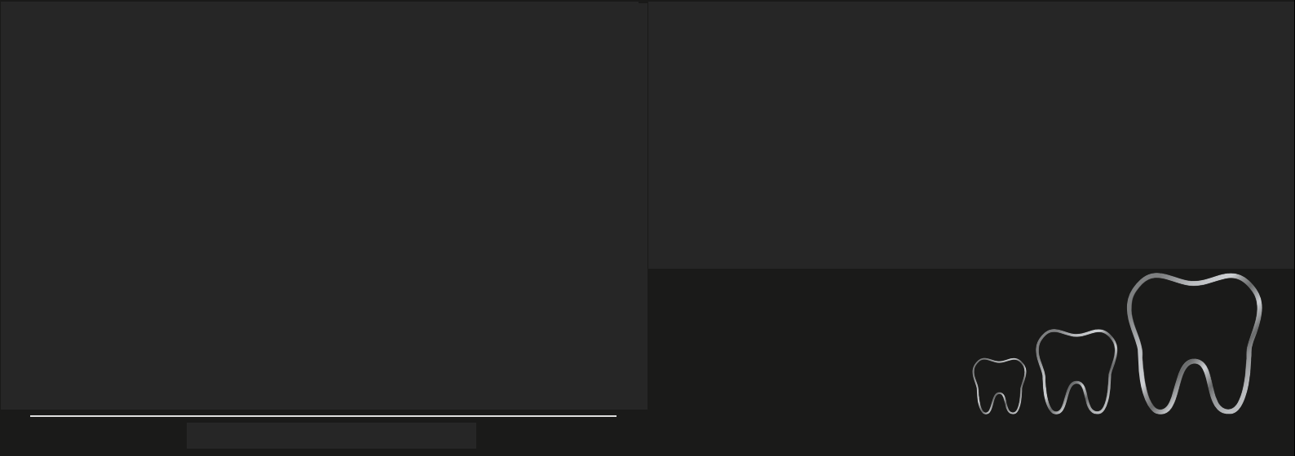
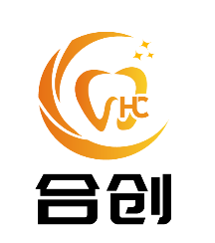

Shenzhen Hechuang Meici Dental Technology Co., Ltd.
Exquisite Natural Comfort
Shenzhen Hechuang Meici Dental Technology Co., Ltd.
Address: No. 1, Beihouxiang Road, Sha'er Community, Shajing Street, Bao'an District, Shenzhen, Guangdong Province
Phone: 15706653175
Website: https://www.kq36.cn/szshcmcckj/

Slide 2
.
Company Introduction
Products:
Shenzhen Hechuang Meici Dental Technology Co., Ltd. is a professional digital technology company in the dental industry, integrating the production, research and development, and sales of dental prostheses. The company focuses on digital production and has a professional team proficient in digital production processes.
Our quality and service have also won the trust and support of our customers. Our company adheres to the principles of quality first and integrity, serving our customers with convenience, speed, high quality, and enthusiasm.
Pure Titanium Malo Bridge
Cercon Zirconia
Aesthetic Veneers
Digital Milled Inlays
E-max
Sirona Zirconia
Lava Zirconia
Wieland Zirconia
Direkt Zirconia
Upcera Zirconia
Aidite Zirconia
Adsorptive Dentures
11

Slide 3

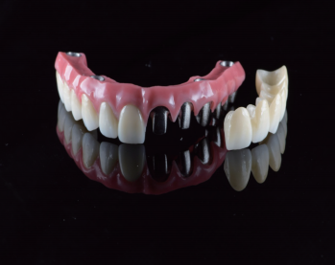

Pure Titanium Malo Bridge
Made from pure titanium: integrally milled without welding. In addition to excellent biocompatibility, it has moderate hardness, low thermal conductivity, and no taste interference. It is also unaffected by MRI and X-ray penetration. It can be divided into single pieces for maintenance, reducing maintenance time for both customers and doctors. It has high aesthetics, good fit with the teeth and alveolar ridge, and excellent functionality and stability of the Malo Bridge.
Stimulates Alveolar Bone
Light and Durable
High Material Quality
High Aesthetics
Material
Pure Titanium
Range
Precision Fit
Strong Retention and Pressure Resistance
Strength
1200HRC
Implant-supported crown /bridge
Advantages
Single crown bonding, more three-dimensional
01

Slide 4
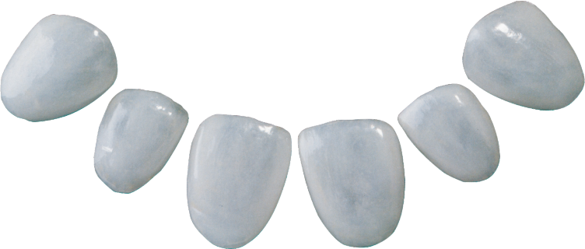
Aesthetic Veneers
The company has assembled a professional aesthetic technical team to design the best aesthetic effect according to the smile type and user requirements, using the most suitable materials and processes. Utilizing 3D scanning, 3D design, and 3D CNC production digital processes, various auxiliary projects can be provided during the consultation process, such as gingival trimming guides, DSD aesthetic images, 3D renderings, temporary tooth guides, and preparation guides. This ensures a more professional and comprehensive dental experience for users, achieving the finest aesthetic restoration results.
Material
Glass Ceramic/Imported Zirconia
Range
Strength
400-1200Mpa
Veneers
Color
20 different veneer colors
Contraindications
Dark colored abutments are not suitable for use
Advantages
High aesthetic effect, closely matching the natural tooth color and shape, providing aesthetic reconstruction of teeth
02

Slide 5
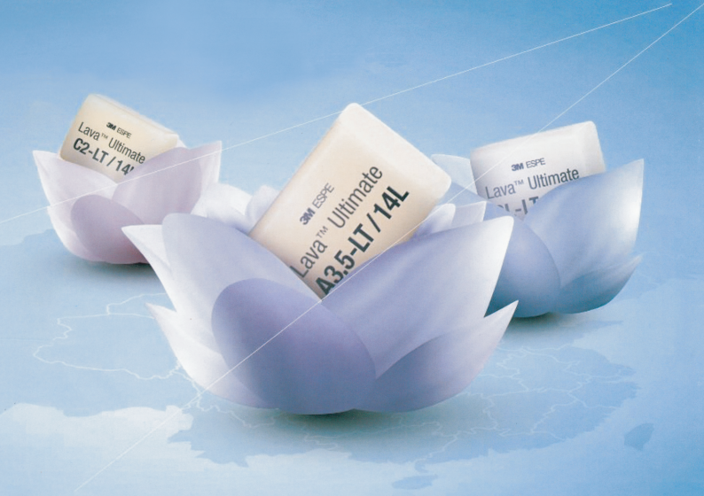
Not suitable for crown or bridge restoration.
Digital Milled Inlays
Utilizing 3D design and 3D CNC production digital processes, the precision is high, the fit is good, and the color is naturally beautiful. During milling and use, the material is not easily cracked or chipped. Therefore, the restoration is more complete, the margins are smoother, and the appearance of inlays, onlays, and veneers is more natural.。
Material
Nanocomposite Ceramic/Glass Ceramic
360 Mpa
8 base crown colors
Range
Strength
Inlay and Onlay
Contraindications
Color
Not suitable for crown or bridge restoration.
High precision, good fit, natural and beautiful color, high edge integrity, and smooth margins, protecting the base tooth and avoiding fractures.
Advantages
03

Slide 6
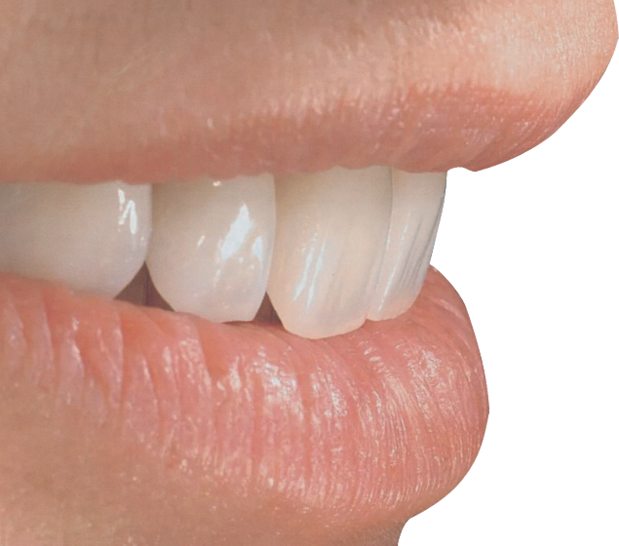
E-max
E.max is derived from the pressed ceramic system of Ivoclar Vivadent. It is renowned for its innovative lithium disilicate glass-ceramic (LS2) blocks and pressing technology. E.max has a unique translucency effect, and its anterior aesthetic restorations have been clinically validated for many years and recognized by dentists worldwide. With the development of digital dentistry, E.max offers high-strength and durable IPS e.max CAD blocks, which have been widely applied and clinically validated over the long term.。
Material
Lithium Disilicate Glass Ceramic (Liechtenstein)
Range
Veneer
Inlay
Onlay
Strength
360-400Mpa
Crown
Bridge
Note: Can fabricate a 3-unit bridge. The bridge extends to the farthest to the 5th tooth position, with only one missing unit.
Color
20 base crown colors
Advantages
High aesthetic and
optical effects
Contraindications
Cannot make a cantilever bridge.
04

Slide 7
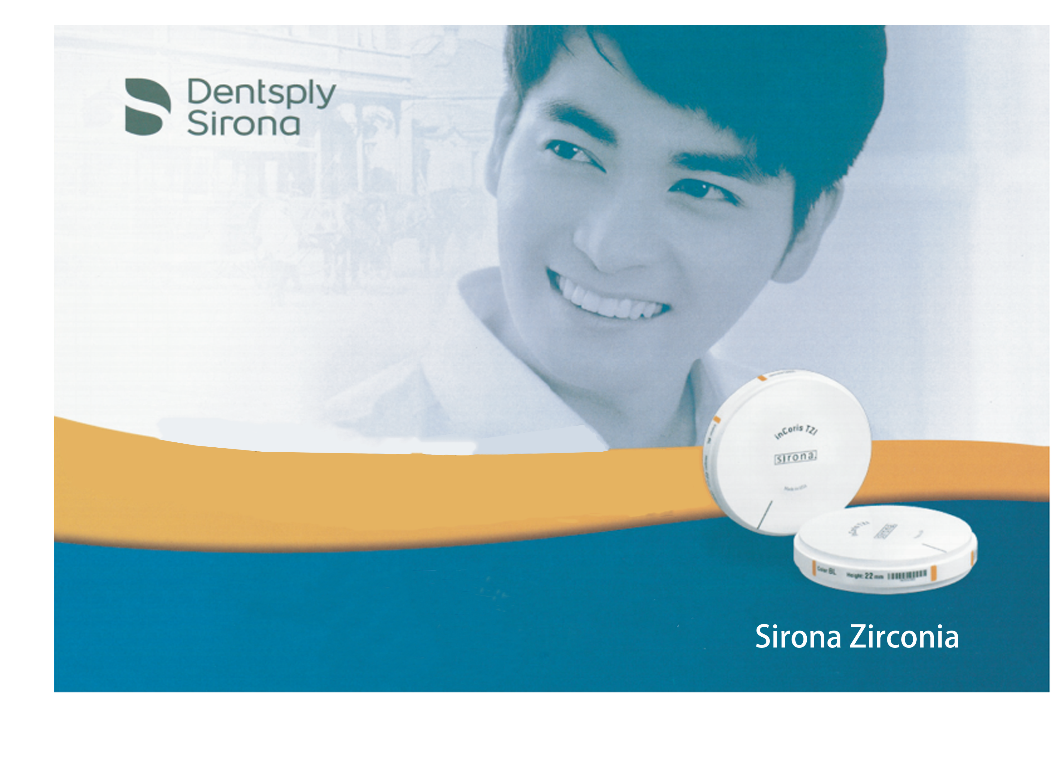
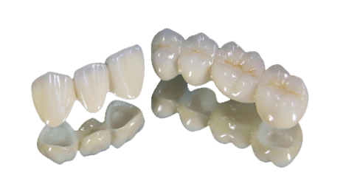
Sirona Zirconia
Sirona (Incoris) zirconia is a prestigious product under Dentsply Sirona, imported from Germany using high-quality materials. It features a global independent anti-counterfeiting verification system. Sirona is dedicated to the research, development, and production of digital solutions for oral care, continually updating and upgrading its processes from raw materials to digital equipment to comprehensive systems for dental prosthetics, ensuring safety, speed, and high quality. This fully meets the clinical needs of doctors and the diagnostic and treatment needs of patients.
Material
Zirconia (Germany)
After staining, there are 26 shades of base crowns
Range
Strength
Crown
Bridge
Inlay
Implant-supported crown /bridge
1200Mpa
Color
Note: Can produce porcelain fused to metal (PFM)/all-zirconia crowns, bridges, inlays, onlays, inlay/onlay bridges, and a 14-unit dental bridge.
Originating from German production
The zirconia blocks processed using liquid-phase sintering technology ensure uniform distribution of density and strength.
Advantages
05

Slide 8
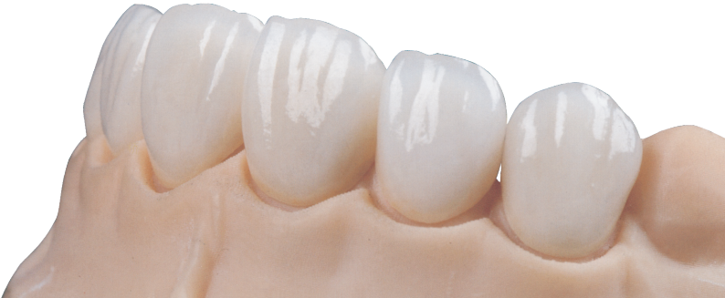
Lava Zirconia
In 2001, Lava zirconia all-ceramic was launched in the United States and is currently used in nearly 50 countries, with over a million Lava zirconia restorations serving patients. In 2010, the Lava zirconia all-ceramic system officially entered the mainland Chinese market, combining the ultra-high precision system of a Fortune 500 company with leading technical craftsmanship, creating celebrity smiles for Chinese consumers.。
Material
Zirconia (USA)
Range
Crown
Inlay
Strength
Bridge
Implant-supported crown /bridge
1200Mpa
Note: Can produce porcelain fused to metal (PFM) / all-zirconia crowns, bridges, inlays, onlays, inlay/onlay bridges, and a 14-unit dental bridge.
Color
16 base crown colors after staining
Advantages
Unique global and dual anti-counterfeiting measures in China.
06

Slide 9
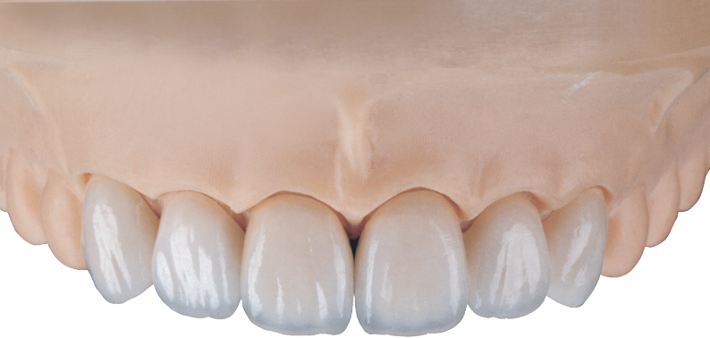
Zircon
Cercon Zirconia
Cercon is a top-tier dental product under the renowned dental company Dentsply Sirona, being the world's first brand to introduce the CAD/CAM concept into the design and manufacturing of zirconia all-ceramic teeth. Launched in 2001, the Cercon system has undergone over a decade of evidence-based medical validation, confirming its safety for both short-term and long-term use.
Material
Zirconia (Germany)
1200 Mpa
Range
Strength
Crown
Bridge
Inlay
Implant-supported crown /bridge
Color
6 pre-shaded zirconia blocks26 base crown colors after staining
Note: Can produce porcelain fused to metal (PFM) / all-zirconia crowns, bridges, inlays, onlays, inlay/onlay bridges, and a 14-unit dental bridge.
Advantages
TrueColor technology, accurate colors
07

Slide 10
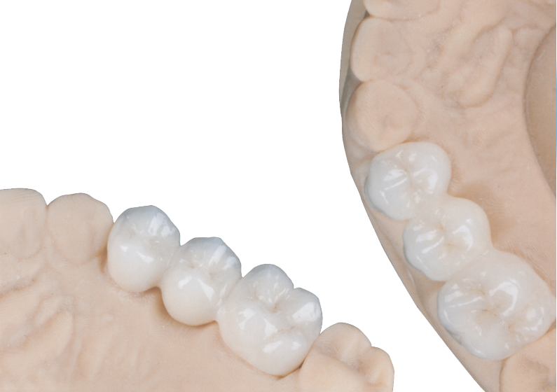
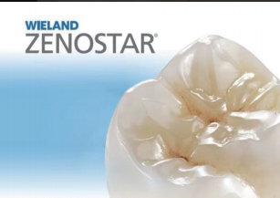
Wieland Zirconia
VITA Zahnfabrik's Zenostar Pure Ceramic is the flagship zirconia brand under the German company VITA Zahnfabrik. It is crafted using the patented ZENOSTAR all-ceramic material. Founded in Germany with a century of technological expertise, VITA Zahnfabrik became a group member of Ivoclar Vivadent AG in November 2012, ensuring full compatibility with the IPS e.max system.
Material
Zirconia (Germany)
Range
Strength
1200±200 Mpa
Crown
Bridge
Inlay
Implant-supported crown /bridge
Color
7 pre-shaded zirconia blocks16 base crown colors after staining
Note: Can produce porcelain fused to metal (PFM) / all-zirconia crowns, bridges, inlays, onlays, inlay/onlay bridges, and a 14-unit dental bridge.
Advantages
The colors are accurate, no need for veneering, the texture remains flawless.
08

Slide 11
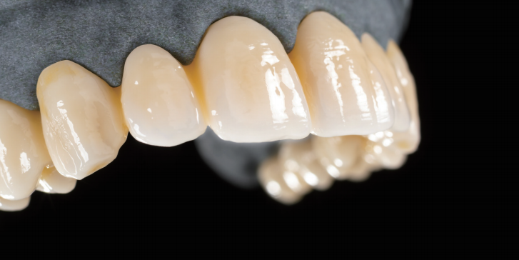
Direkt Zirconia
Utilizing zirconia materials imported from Germany, closely mimicking human tooth characteristics. The material features multiple layers of color gradients from cut to tooth end, with a transparency up to 49.4%. The product offers excellent aesthetic tones, achieving natural and realistic aesthetics without requiring veneering. It also boasts high strength, durability, and resistance to fracturing. With a strength approaching approximately 1100 MPa, its moderate strength characteristics make it suitable for implant restorations, minimizing stress on adjacent teeth and maintaining stability of the implants.
Material
Zirconia
1100 Mpa
Range
Strength
Crown
Bridge
Inlay
Implant-supported crown /bridge
Color
16 base crown colors after staining
Note: Can produce porcelain fused to metal (PFM) / all-zirconia crowns, bridges, inlays, onlays, inlay/onlay bridges, and a 14-unit dental bridge.
Advantages
Multi-layer tooth shades, 49.4% high translucency
09

Slide 12
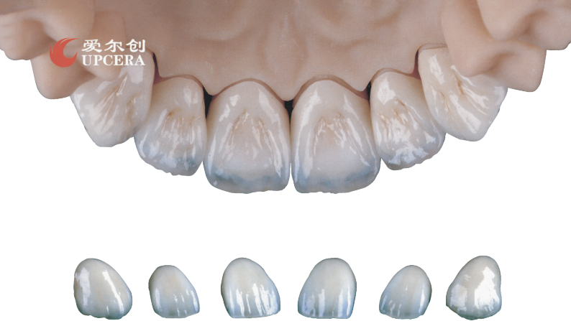
Uqcera Zirconia
Uqcera is the first domestic enterprise with full intellectual property rights in zirconia ceramic block production, breaking through the patent technology monopoly of imported zirconia ceramic blocks. It is a nationally influential dental material supplier. Currently, Archer's dental materials are used in over 60 countries and regions including the United States, Southeast Asia, Europe, the Middle East, South America, Africa, South Korea, India, and Vietnam, earning widespread acclaim and popularity among users.
Material
Zirconia
Range
Strength
1100MPa，600-1100MPa
(Five-layer gradient with two strength options available.
Crown
Bridge
Inlay
Implant-supported crown /bridge
Color
16 pre-shaded zirconia blocks
Five-layer overlay, nine-layer gradient zirconia raw material
Note: Can produce zirconia crowns, porcelain-fused-to-metal crowns (single and bridge),
14-unit dental bridges (limited to one missing posterior tooth)
Advantages
10

Slide 13
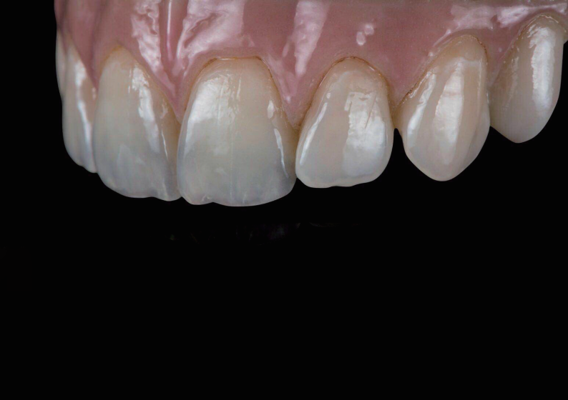
Aidite Zirconia
Aidite is a global dental service provider that integrates research, development, production, service, and digital comprehensive solutions for dental materials and equipment. As of December 31, 2023, Aidite has been granted 93 patents and operates in over 120 countries and regions worldwide. It has subsidiaries in the United States, Germany, and South Korea to serve overseas customers. The company serves over 10,000 dental labs, clinics, and oral hospitals, benefiting approximately 90 million end patients with high-quality Aidite services.
Material
Zirconia (China)
Range
Strength
600-1200MPa
Crown
Bridge
Inlay
Implant-supported crown /bridge
Note: Can produce zirconia crowns, porcelain-fused-to-metal crowns (single and bridge),
14-unit dental bridges (limited to one missing posterior tooth)
Color
4 pre-shaded zirconia blocks
16 base crown colors after staining
Advantages
Natural and realistic three-dimensional gradient color intensity,comparable to anterior teeth
11

Slide 14
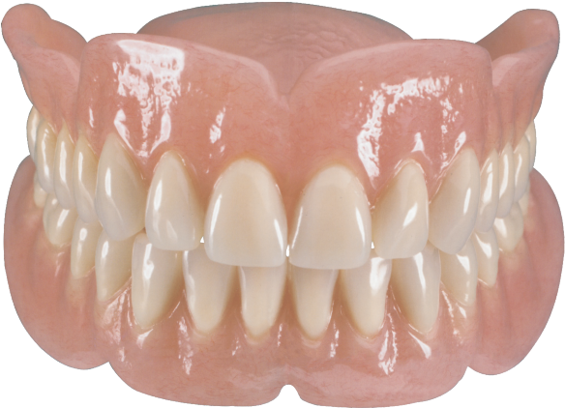
Adsorptive Dentures
Effectively solves the needs of fully edentulous patients who cannot undergo implant restoration due to systemic diseases or insufficient bone volume, restoring chewing and pronunciation functions with strong adsorption
1
2
Exceptional adhesive strength, restoring chewing and speech functions.
Personalized simulation of tooth alignment, realistically restoring mucosal folds
3
4
Close adaptation to anatomical tissue structures, without pressure sensitivity
High strength base+imported plastic steel teeth, durable and long-lasting
12

